Slide 1
Team 55: National Firefighter Registry
A CDC-NIOSH Project
09/20/2020

Slide 2
Agenda
Introduction and Background
Scope of National Fire Registry
Our Role
Solution Architecture
Project Plan

Slide 3
Why create the National Firefighter Registry?
Firefighters at higher risk for various cancers, respiratory conditions, etc.
Limited information on long-term health of firefighters
Need for long-term medical information and inclusion of women and minorities
Creation spurred by passing of Firefighter Cancer Registry Act of 2018
Notes:
References:
Health risks: https://www.cdc.gov/niosh/firefighters/health.html

Slide 4
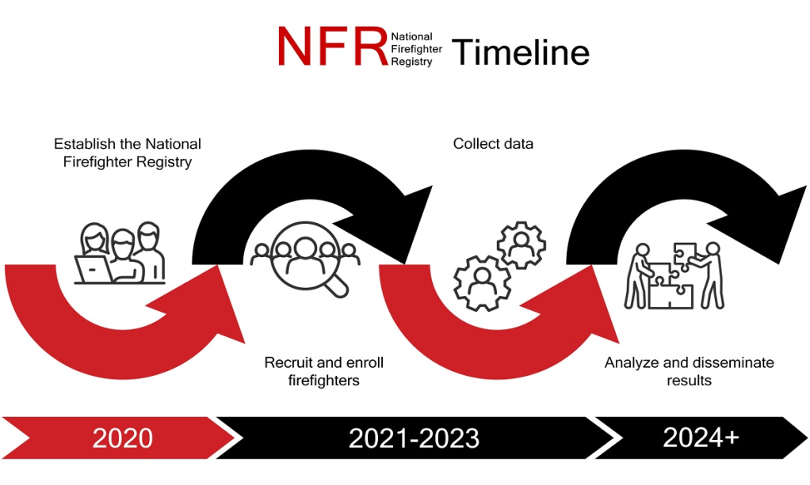
National Firefighter Registry
CDC project to track health information of firefighters to analyze cancer trends
Enrollment is on a volunteer basis
Goal is >200,000 firefighters enrolled
Source: https://www.cdc.gov/niosh/firefighters/registry.html

Slide 5
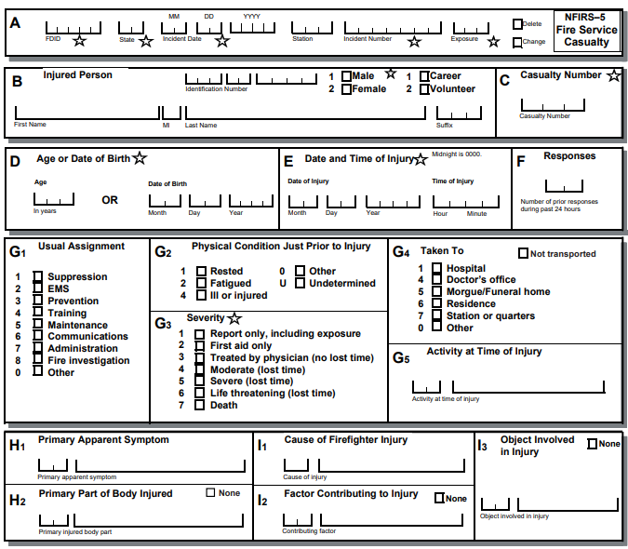
Our Role
Existing NFIRS casualty form not FHIR compatible
Goal: create FHIR implementation guide (IG) for NFIRS casualty form
Source: NFIRS Reference Guide (2015) pp. 182

Slide 6
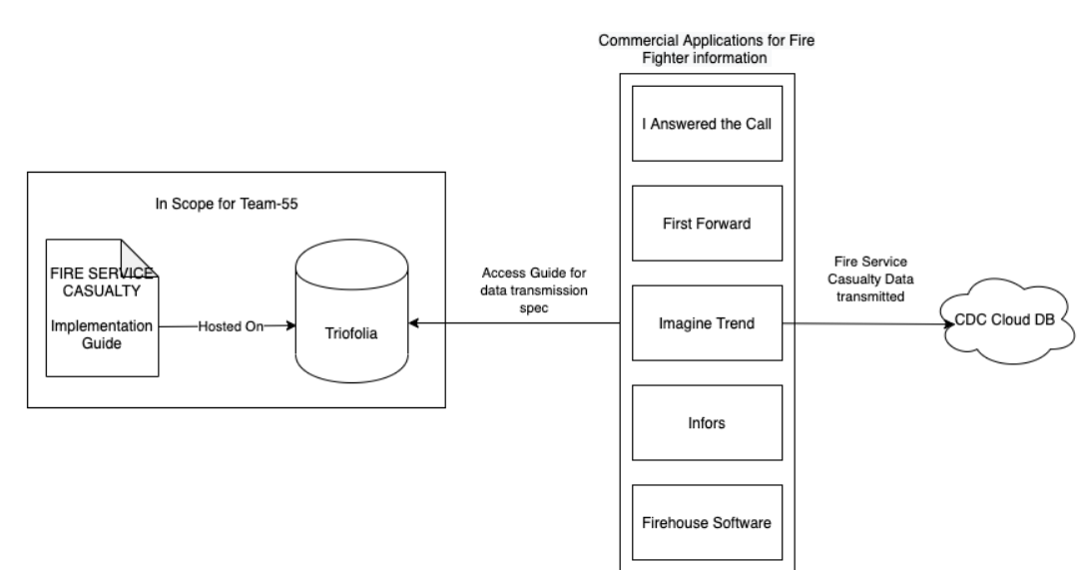
Solution Architecture
Plan: Use Trifolia-on-FHIR for IG Creation

Slide 7
Project Plan

Slide 8
Backup

Slide 9
Project Plan
Key development tasks are translation of sections of NFIRS Casualty form to FHIR standard
QA follows behind translation, ensuring correctness
Final deliverable is implementation guide

Slide 10
Project Plan

Slide 11
Project Plan

Slide 12
Project Plan

